Slide 1
POWERSHELL MODULE
LIFECYCLE
EBRU CUCEN

Slide 2

ABOUT ME
EBRU CUCEN
@ebrucucen
https://github.com/ebrucucen
Co-ordinator for Get-PSUGUK
Associate Trainer for DevOps Tools
.NET dev\trainer turned into software lifecycle inhabitant

Slide 3
Agenda
Script Modules
Lifecycle of Modules

Slide 4
SCRIPT MODULE
Control
public/private functions/variables
Group
reuse/abstraction
Describe
versions, dependencies

Slide 5
script module - [CONTROL]
Text
#Get public and private function definition files.
$Public = @( Get-ChildItem -Path $PSScriptRoot\Public\*.ps1 -ErrorAction SilentlyContinue )
$Private = @( Get-ChildItem -Path $PSScriptRoot\Private\*.ps1 -ErrorAction SilentlyContinue )
#Dot source the files
Foreach($import in @($Public + $Private))
{
Try
{
. $import.fullname
}
Catch
{
Write-Error -Message "Failed to import function $($import.fullname): $_"
}
}
Export-ModuleMember -Function $Public.Basename

Slide 6
mODULE MANAGEMENT
New-Module
New-ModuleManifest
Import-Module
Get-Module
Export-ModuleMember
Remove-Module
Test-ModuleManifest

Slide 7
script module [group]
Text
appveyor.yml
deploy.PSDeploy.ps1
main.build.ps1
README.md
PSEventLogEntry\
en-US\
Public\
Private\
Test\
PSEventLogEntry.psd1
PSEventLogEntry.psm1

Slide 8
script module [describe]
Text
New-ModuleManifest -path .\sample.psd1
https://github.com/ebrucucen/PSModules/blob/master/sample.psd1
https://github.com/ebrucucen/PSModules/blob/master/PSEventLogEntry/PSEventLogEntry.psd1

Slide 9
what is the big picture?

Slide 10
powershell lifecycle
Local
source
central
repo
CI/CD
deploy
link project
define
workflow
build
test
package

Slide 11

SELECTED TOOLSET for powershell
Local
source
central
repo
CI/CD
deploy
link project
define
workflow
build
test
package
GIT
GITHUB
APPVEYOR
invoke build
pester
nuget
POWERSHELLGALLERY
github
bitbuket
vso
install module
api key
appveyor encrypt
abc
This slides will cover

Slide 12
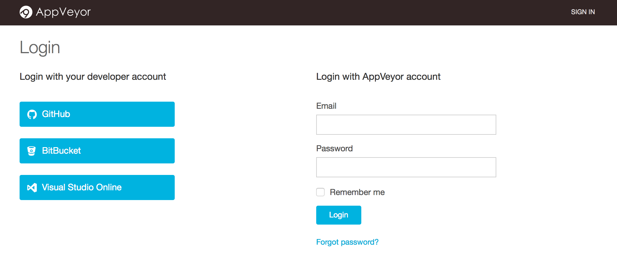
Link project
Step1: Sign in:
https://ci.appveyor.com/login
Step2: Login with with developer/AppVeyor account

Slide 13
Link project
Step3: Select the project to link

Slide 14
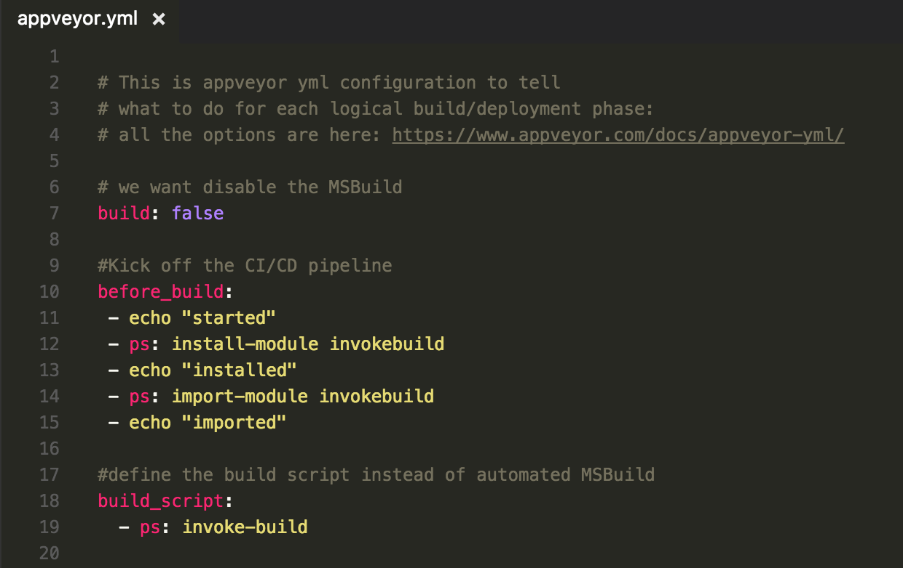
link project
Step4: Add appveyor.yml
https://github.com/ebrucucen/PSModules/blob/master/appveyor.yml

Slide 15
AppVeyor reference*
GENERAL
ENVIRONMENT
BUILD
TEST
package
DEPLOY
notification
global handlers
skip_commits:
init:
before_build:
before_test:
artifacts:
before_deploy:
provider:
on_success:
- message:
image:
build:
test:
- path:
deploy:
on_build_success:
on_failure:
- author:
hosts:
build_script:
test_script:
deploy_script:
on_build_failure:
on_finish:
install:
after_build:
after_test:
after_deploy:
on_build_status_changed:
- git config
no need MSBuild
we’ll run Pester
alternative to PSDeploy
providers: Email, HipChat, Slack, Campfire, Webhook
- build: off
- test: off
- provider:
- artifact:
we’ll run Invoke-Build script
providers: Local, FTP, WebDeploy, AzureCS, AzureBlob, S3, NuGet, Environment
- build: - ps:
- deploy: off/on
*These are options relevant for a PowerShell lifecycle
after_deploy:

Slide 16
define workflow
# Define properties such as: # Test/Output Directories … task Init { # Initial tasks such as: # Install/Import packages … } task Build -Depend Init{ #Build tasks such as: #Generate the resources you want … } task Test{ #Test tasks such as: #Run Invoke-Pester … } task Deploy{ #Deploy tasks such as: #Run PSDeploy.ps1 } task Clean { #Clean tasks such as: #Remove test files } #Define the order you want to call: task . Init, Build, Test, Clean, Deploy
Invoke-Build calls
*.build.ps1
[from the same level]
a template on the right hand side:
the last line calls the tasks in order:
task . Init, Build, Test, Clean, Deploy

Slide 17
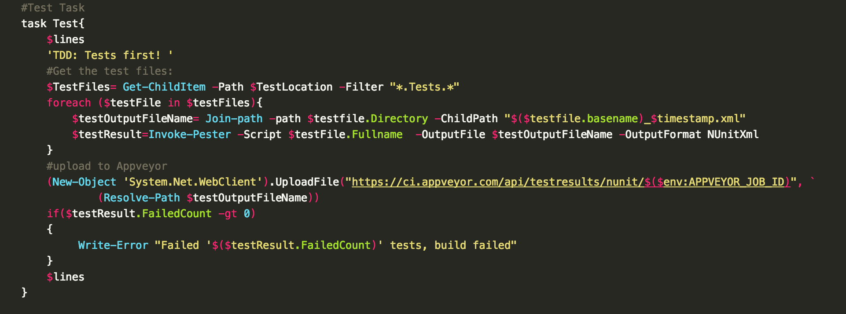
test example
main.Build.ps1 Test task :

Slide 18


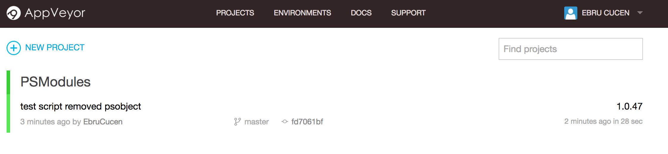
enjoy automated ci output
README.md on Github site can display the status:
Appveyor website will have all build history, logs …

Slide 19
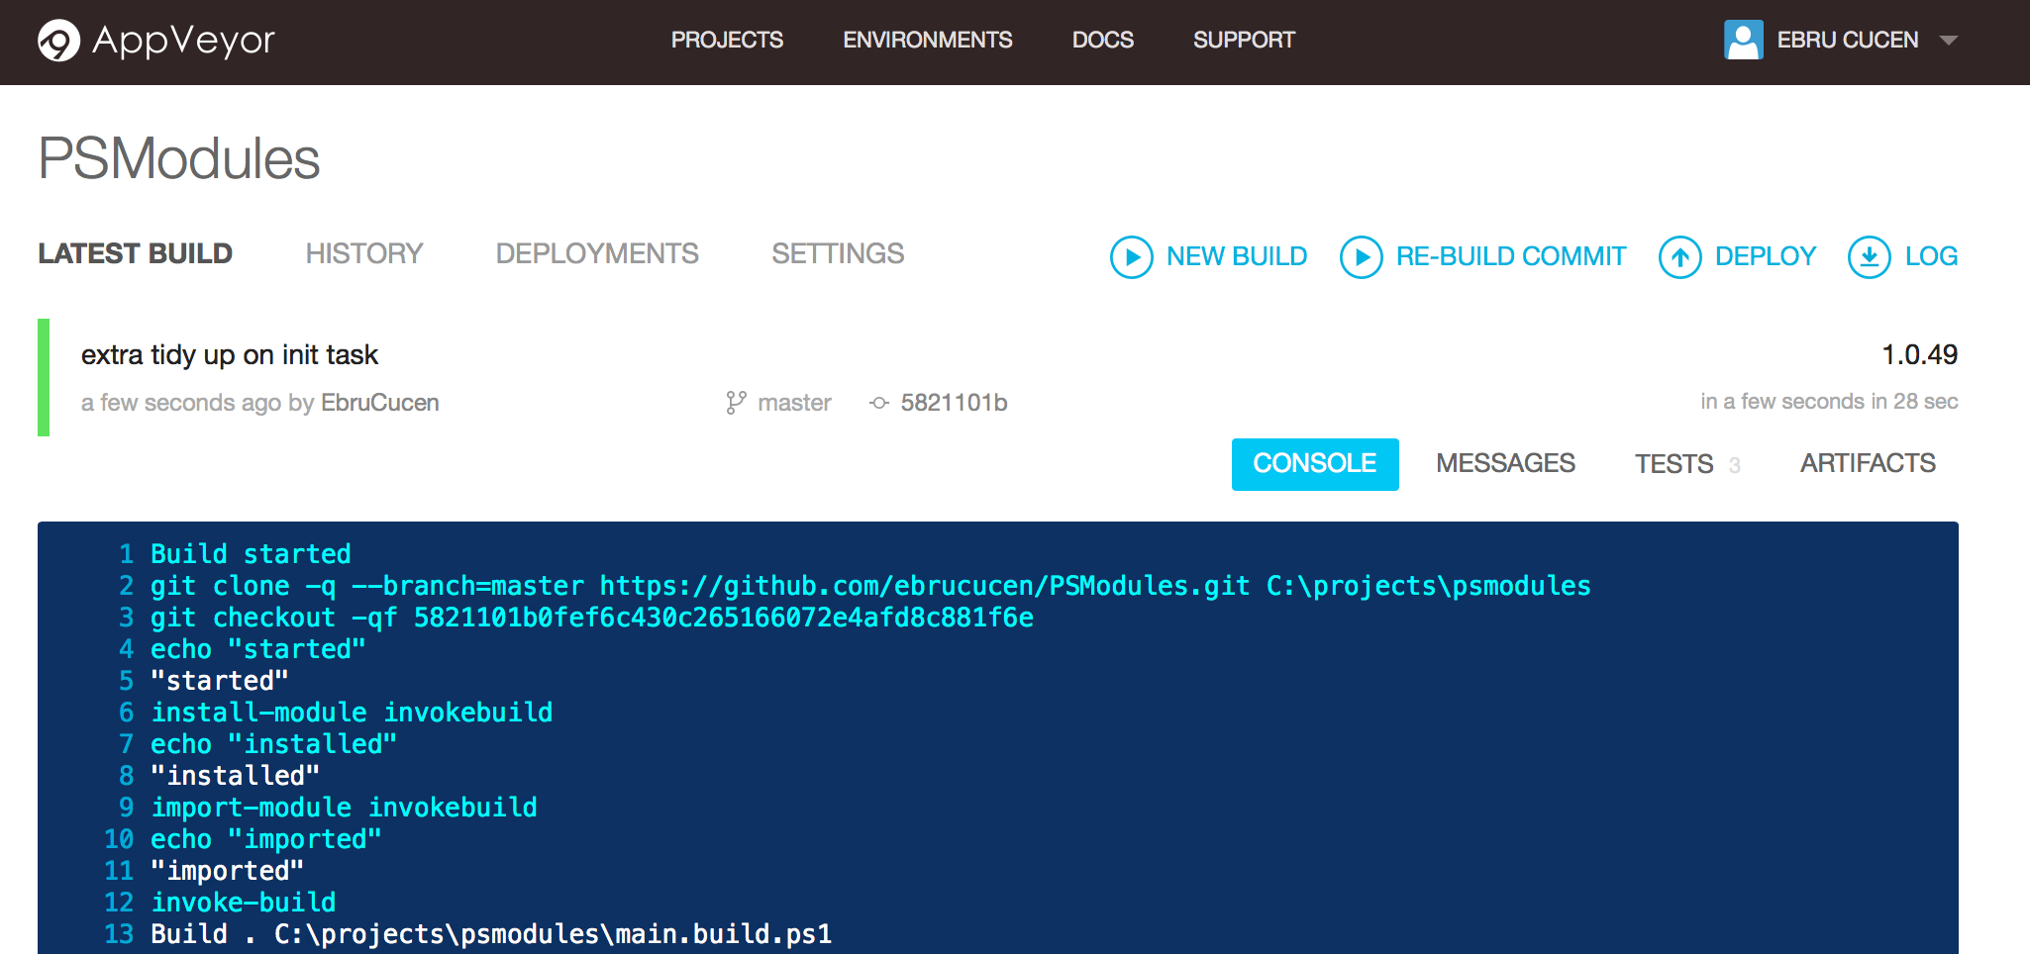
build output [1: appveyor.yml called]

Slide 20
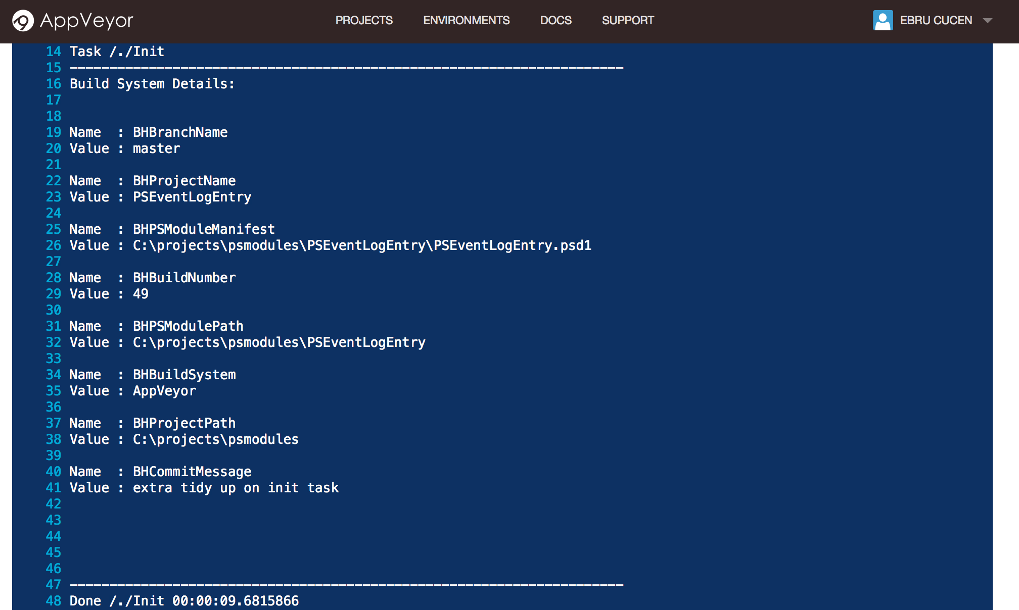
build output 2: [init task in main.build.ps1 called]

Slide 21
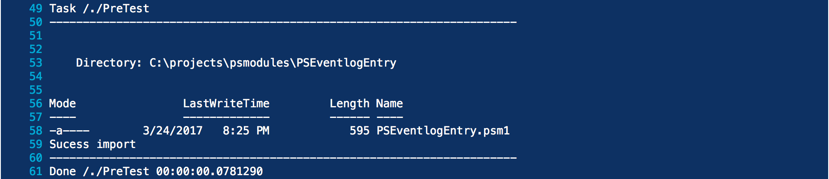
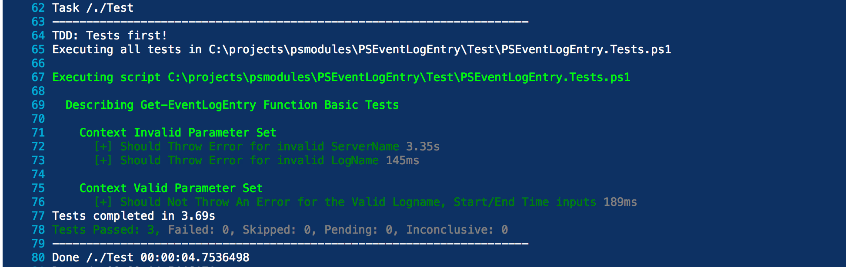
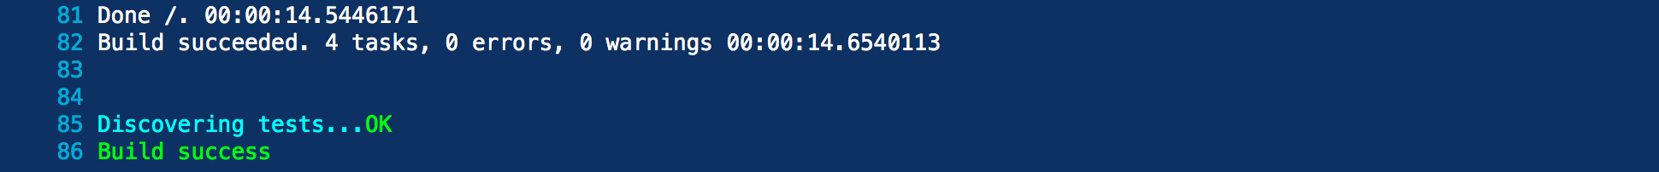
build output 3: [pretest, test]

Slide 22
References
Invoke-build: https://github.com/nightroman/Invoke-Build
My examples:
https://github.com/ebrucucen/PSModules
https://ci.appveyor.com/project/ebrucucen/psmodules
More github badges?
https://shields.io
Appveyor:
https://www.appveyor.com/docs/appveyor-yml/
https://ci.appveyor.com/tools/encrypt
https://github.com/PowerShell/DscResource.Tests/blob/dev/AppVeyor.psm1
Devops:
https://xebialabs.com/periodic-table-of-devops-tools

